Slide 1
Program
MineOperate Technical L1
Measurements, Calibration & Accuracy Testing
Edgar Sepulveda
Global Technical Manager, MineOperate
09/14/2022
Version 1.1

Slide 2

Purpose
This session introduces HP Shovel NAV calibration process and accuracy test.
At the end of this module, you will:
know the process to calibrate a HP Shovel using NAV application.
know some ways to do an accuracy test for HP Shovels.

Slide 3
HP Shovel Variants
The J2shovel product is used on a variety of Equipment Models which have physically different geometries.
Hydraulic Face Shovel (where the bucket faces away from the operator)
Excavator/Backhoe (where the bucket faces towards the operator)
Front-End Loader
With a dogbone (eg. CAT992)
With a Z-bar (eg. CAT994)
Electric Rope Shovel
Fixed Offset
NAV tab and Non-NAV tab (APAC and Tucson)
The focus on this training is on the NAV tab version.

Slide 4
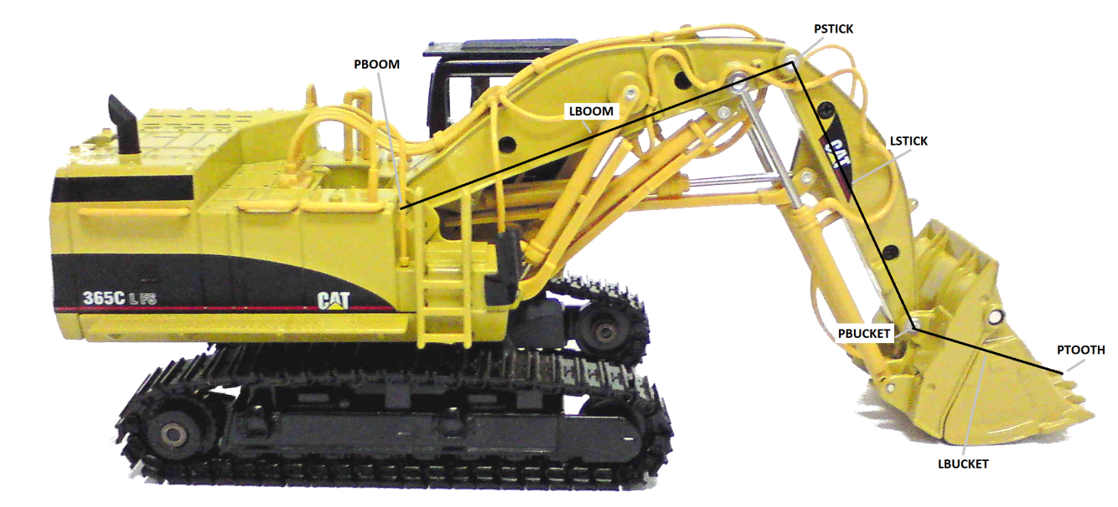
Geometry Measurements – Hydraulic Face Shovel
Topics
What Geometry Parameters are used?
How to measure a Face Shovel
Processing the survey points
Entering the Geometry
What Geometry Parameters are used?
GPS offsets (wrt COR)
Boom Mount offset (wrt COR)
Boom Length
Boom Angle
Stick Length
Stick Angle
Bucket Length
Bucket Angle

Slide 5
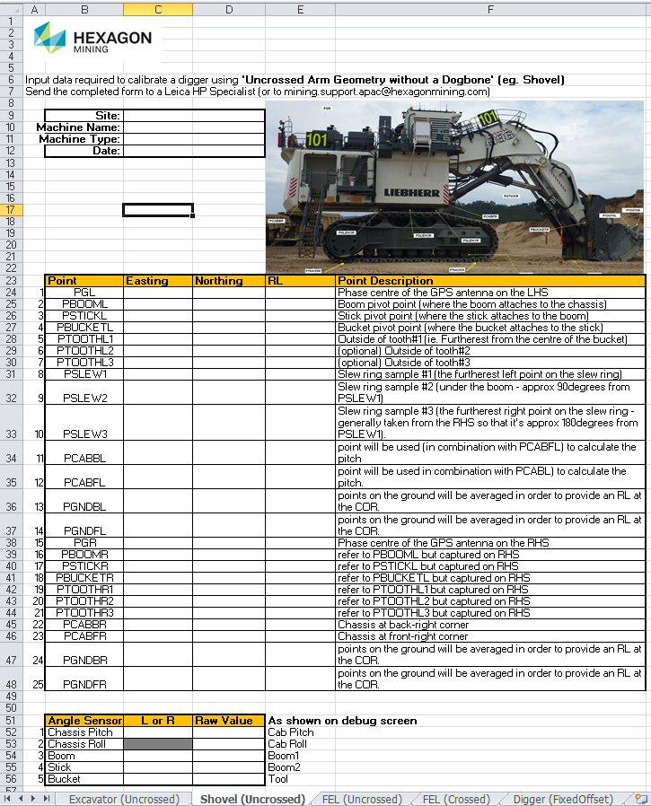
Geometry Measurements
Pre-Survey Steps
Take Photos
Take side-elevation photos of the shovel and send them to a HP specialist to mark-up and show which points are required.
Verify that the inclinometers are working.
The RAW values need to be captured at the same time when the survey is done.
Provide surveyor with the required list of survey points
Refer to JS01-03-12ED.xlsx (J2shovel Survey Data Entry spreadsheet)
It is strongly advisable to discuss the list of points with the surveyor in order to clarify any uncertainties they may have.
Provide surveyor with ‘Surveying Tips’ PDF
Refer to JS01-03-06 Appendix A.pdf

Slide 6
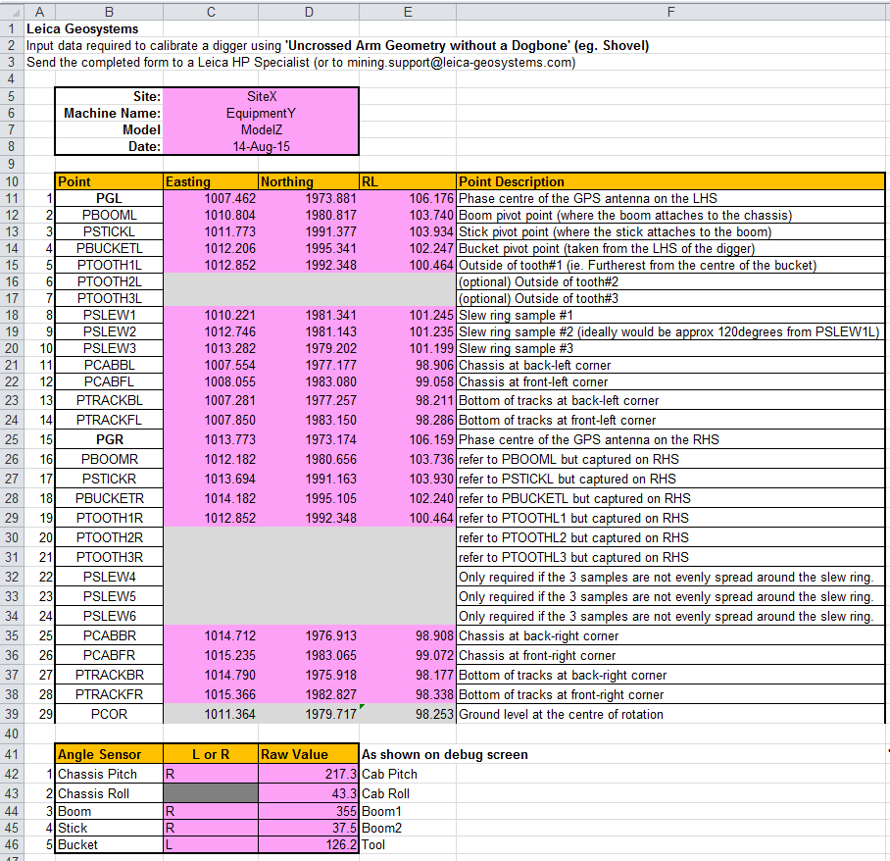
Geometry Measurements
While Surveying the Shovel
Take Photos
Take side-elevation photos of the shovel while it’s parked up and being surveyed. This will help the HP specialist to perform some sanity checks on the calculated angles.
Capture the RAW values for each of the inclinometers
Physically inspect each sensor and confirm whether facing LHS or RHS.
Assist the surveyor to shoot the points
Make sure that the labels for each point are correct to avoid confusion.
Populate the ‘Survey Data Entry’ sheet and send to HP specialist to process.

Slide 7
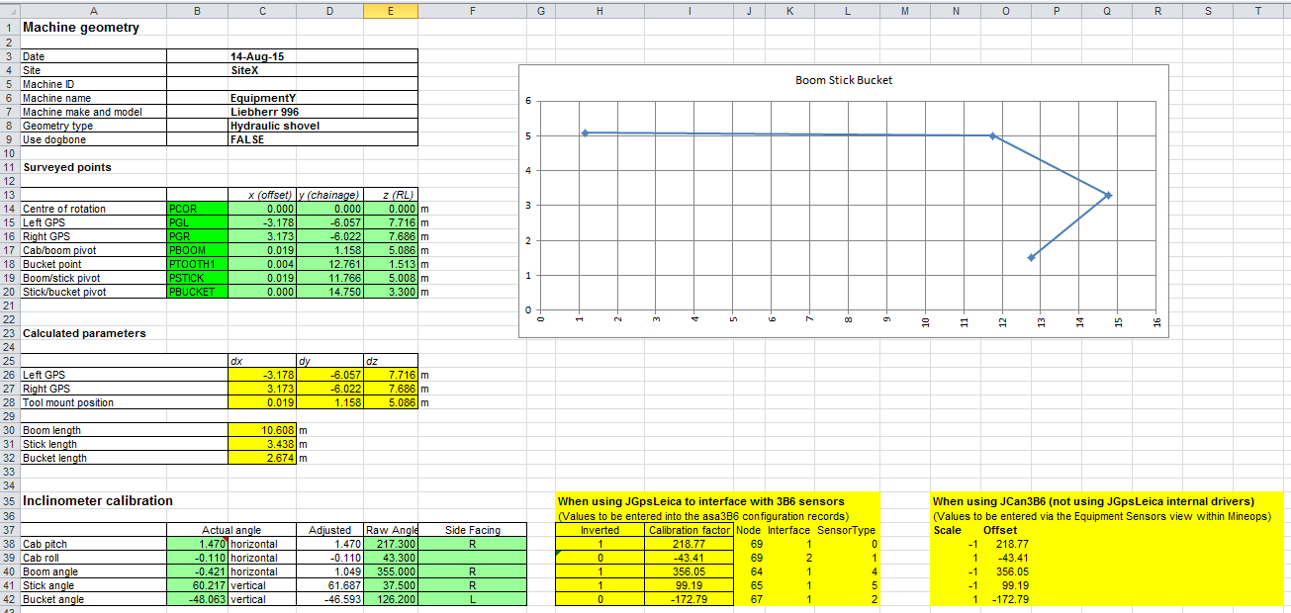
Geometry Measurements
Processing the Surveying Points
The list of survey points should be provided to a HP specialist who is familiar with the process of converting the points.
The calibration spreadsheet only produces output suitable for JGpsLeica configs.
Manual conversions will need to be performed to calculate the geometry_segment data for non JGpsLeica systems.

Slide 8
Geometry Measurements – Face Shovel
Entering the Geometry Measurements into MineOps
JGpsLeica version uses the configurations table.
Non-JGpsLeica version uses the geometry_segments table
Values expressed in centimeters
Module | Attribute | Value
gps/gpsLeica | uncrossedArmGeom | isShovel=1 toolMountPositionDx=0.0 toolMountPositionDy=0.8 toolMountPositionDz=5.5 boomLength=8.0 stickLength=5.0 bucketLength=3.5 bucketWidth=3.0 bucketDepth=3.0 useDogBone=0

Slide 9
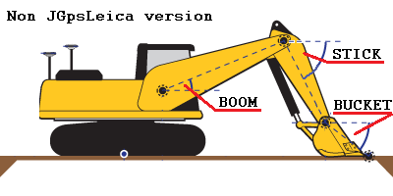
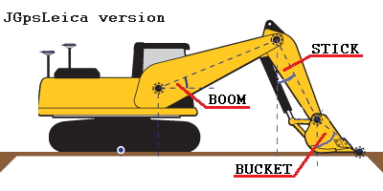
Inclinometer Calibration
What Do the Angles Mean?
Non-JGpsLeica version
Boom, Stick, Bucket angles are all relative to horizontal.
JGpsLeica version
Boom angle relative to horizontal.
Stick and Bucket angles are relative to Vertical.

Slide 10
Inclinometer Calibration
Alternative Methods to Calibrate Inclinometers
During the survey process
As long as the RAW values are also captured at the same time as when the shovel is surveyed, the offsets can be determined by calculating the actual angles from the survey data points.
This is the most efficient and least intrusive method (ie. Only need access to the shovel once).
Getting the operator to move the boom, stick, bucket into known positions eg. Horizontal, vertical etc.
This still relies on having someone (eg. A surveyor) to tell the operator when the boom is level etc.
It’s a relatively easy process, but prone to small errors.
If the boom, stick, bucket lengths are already known, the actual angles of the boom, stick, bucket can be calculated by using a TPS to sample the RL for the boom pivot, stick pivot, bucket pivot & tooth points.
This is the simplest method to ‘recalibrate’ existing sensors. There is no need to resurvey the whole shovel just to calibrate the inclinometers.
Relies on the ‘JS01-03-20.xls’ (Shovel Sensor Recalibration)

Slide 11
Inclinometer Calibration
Manually Calculating the Inclinometer Scale and Offset
The scale is determined by which way the 3B6 sensor is facing
If facing LHS, scale = +1 (or null). For OreNav/JGpsLeica, inverted=0
If facing RHS, scale = -1. For OreNav/JGpsLeica, inverted=1
The offset is calculated using 3 factors:
Scale (either +1 or -1 as per above)
RAW value (in degrees, not tenths of degrees)
ACTUAL angle (calculated using various methods)
ACTUAL_ANGLE = RAW_VALUE * SCALE + OFFSET
If facing LHS, SCALE=1, and OFFSET = ACTUAL_ANGLE – RAW_VALUE
If facing RHS, SCALE=-1 and OFFSET = ACTUAL_ANGLE + RAW_VALUE

Slide 12
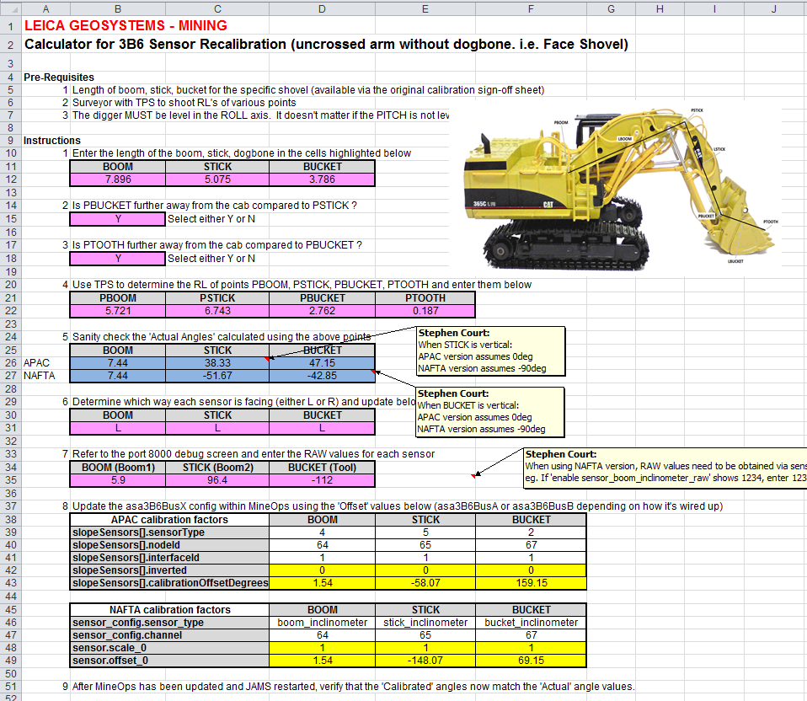
Inclinometer Calibration
Recalibrating the inclinometers (assuming lengths are already known)
The PINK cells need to have data entered
The BLUE cells are the calculated actual angles (based on the TPS measurements).
The YELLOW cells represent the output for both the JGpsLeica and non-JGpsLeica versions.

Slide 13
Accuracy Testing
How to Perform an Accuracy Test
Simple/quick test
Where someone just checks one point.
This method doesn’t conclusively prove that the J2shovel system is accurate for all positions.
More complete testing involves the following:
Sampling multiple points
Reporting the errors in X,Y,Z axis (rather than just a 2D distance).
Capturing additional parameters for each sample point to assist with troubleshooting if required
Azimuth, machine center position etc.
Boom/stick/bucket angles etc.
Refer to J2shovel TRM (or Hardware Training Level 2 Manual).

Slide 14
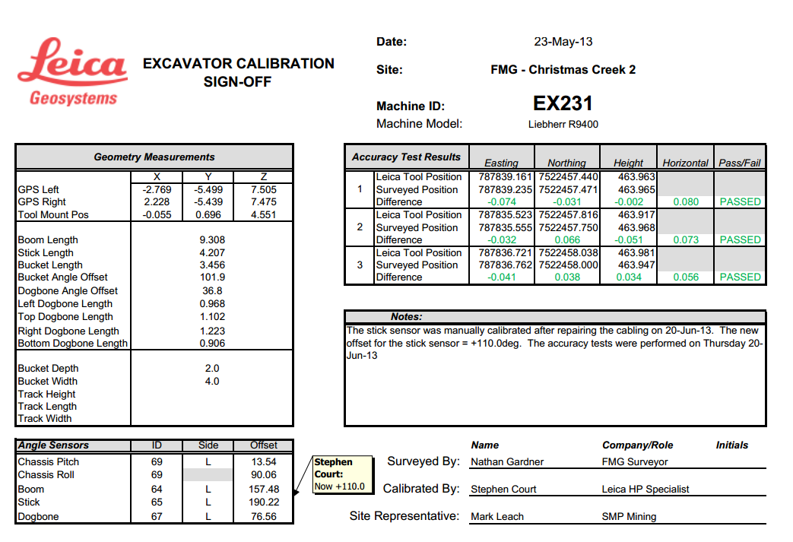
Accuracy Testing
Example Sign Off Sheet
The results for the accuracy tests need to be recorded as evidence that the J2shovel system was accurate.
The calibration parameters (eg. Measurements and sensor offsets) are also captured so that we have a complete set corresponding to the test results.
The sign-off sheet should be provided to the site representatives and also saved into Hexagon’s repository of calibrations.

Slide 15
Resource Material
HP Shovel TRM
Hardware Training Level 2 Manual
https://confluence.hexagonmining.com/download/attachments/53775489/Leica%20Hardware%20Level%202%20Training%20Manual%20v1.2.pdf?version=2&modificationDate=1476076699762&api=v2
J2shovel Survey Data Entry
http://abrisrvfis02:81/Mining/Project%20Engineering/Jigsaw%20System%20Documentation%20Project/JS01%20-%20Products/JS01-03%20-%20DigNavJS/JS01-03-12ED%20-%20DigNavJS%20Survey%20Data%20Entry.xlsx
Shovel Inclinometer Recalibration
http://abrisrvfis02:81/Mining/Project%20Engineering/Jigsaw%20System%20Documentation%20Project/JS01%20-%20Products/JS01-03%20-%20DigNavJS/JS01-03-15ID%20-%20j2Shovel%20Sensor%20Recalibration.xls
Register of J2shovel Calibrations
http://abrisrvfis02:81/Mining/Project%20Engineering/Jigsaw%20System%20Documentation%20Project/JS01%20-%20Products/JS01-03%20-%20DigNavJS/Site%20Calibrations/JS01-03-10ID%20-%20DigNavJS%20Register%20of%20Calibrations.xls

Slide 16
Measurements, Calibration & Accuracy Testing - Questions
True or False The HP Shovel product is used on a variety of Equipment Models which have physically different geometries.
True or False OP Pro has two HP Shovel applications which are known as NAV and Tucson versions.
True or False Boom, Stick, Bucket angles are all relative to horizontal in JGpsLeica version.
True or False The scale is determined by which way the 3B6 sensor is facing, if facing RHS, scale = +1 (or null).
More complete Accuracy Test involves the following:
Sampling multiple points.
Reporting the errors in X,Y,Z axis.
Capturing additional parameters for each sample point, azimuth, angles, etc.
All above

Slide 17
Measurements, Calibration & Accuracy Testing - Answers to Questions
True or False The HP Shovel product is used on a variety of Equipment Models which have physically different geometries. True
True or False OP Pro has two HP Shovel applications which are known as NAV and Tucson versions. True
True or False Boom, Stick, Bucket angles are all relative to horizontal in JGpsLeica version. False
True or False The scale is determined by which way the 3B6 sensor is facing, if facing RHS, scale = +1 (or null). False
More complete Accuracy Test involves the following:
Sampling multiple points.
Reporting the errors in X,Y,Z axis.
Capturing additional parameters for each sample point, azimuth, angles, etc.
All above

Slide 18

THANK
Y
O
U

